Slide 1
Survey Questions and Codebook

Slide 2
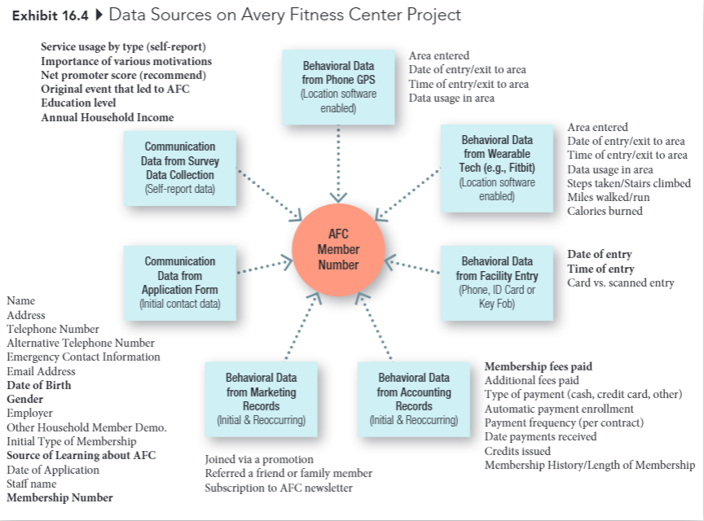
Avery Fitness Center Project

Slide 3
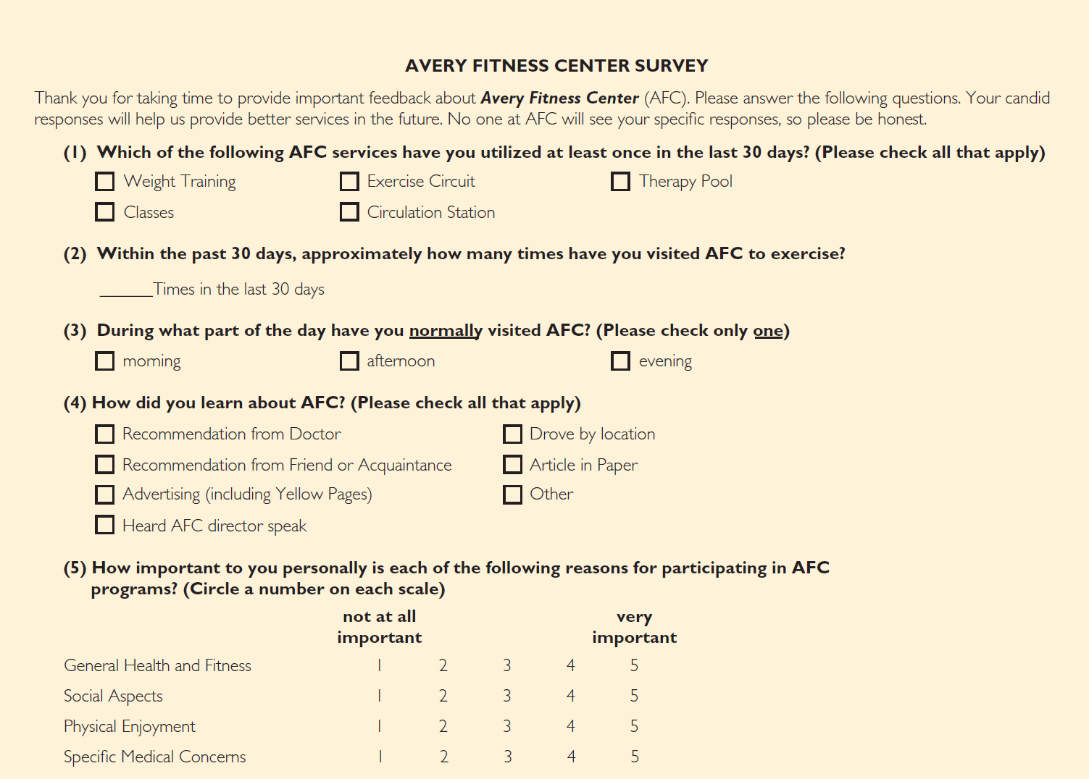
Avery Fitness Center Survey (1 of 2)

Slide 4
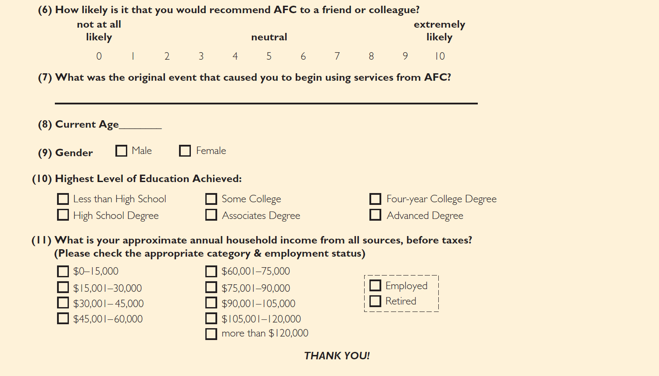
Avery Fitness Center Survey (2 of 2)

Slide 5
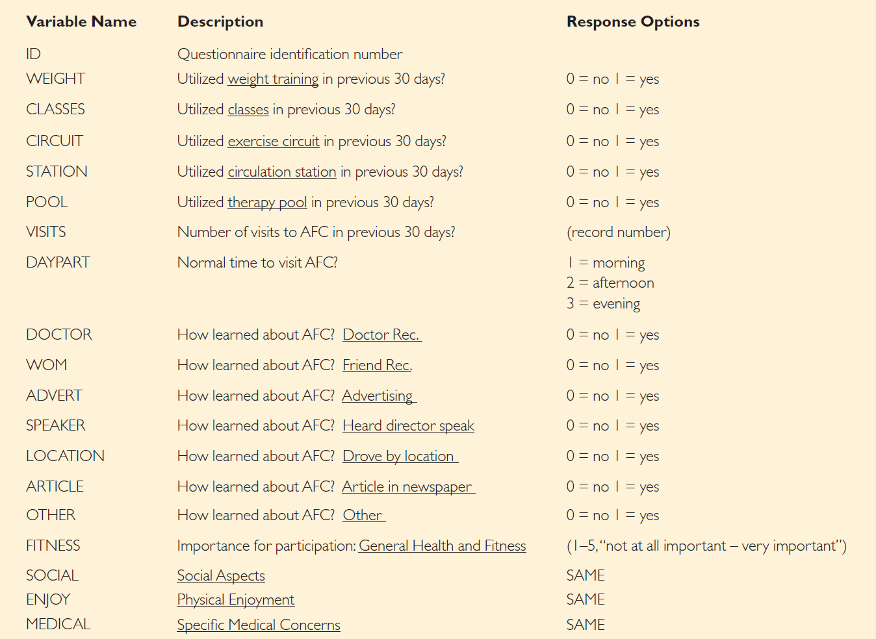
Developing a Codebook (2 of 3)
Codebook

Slide 6
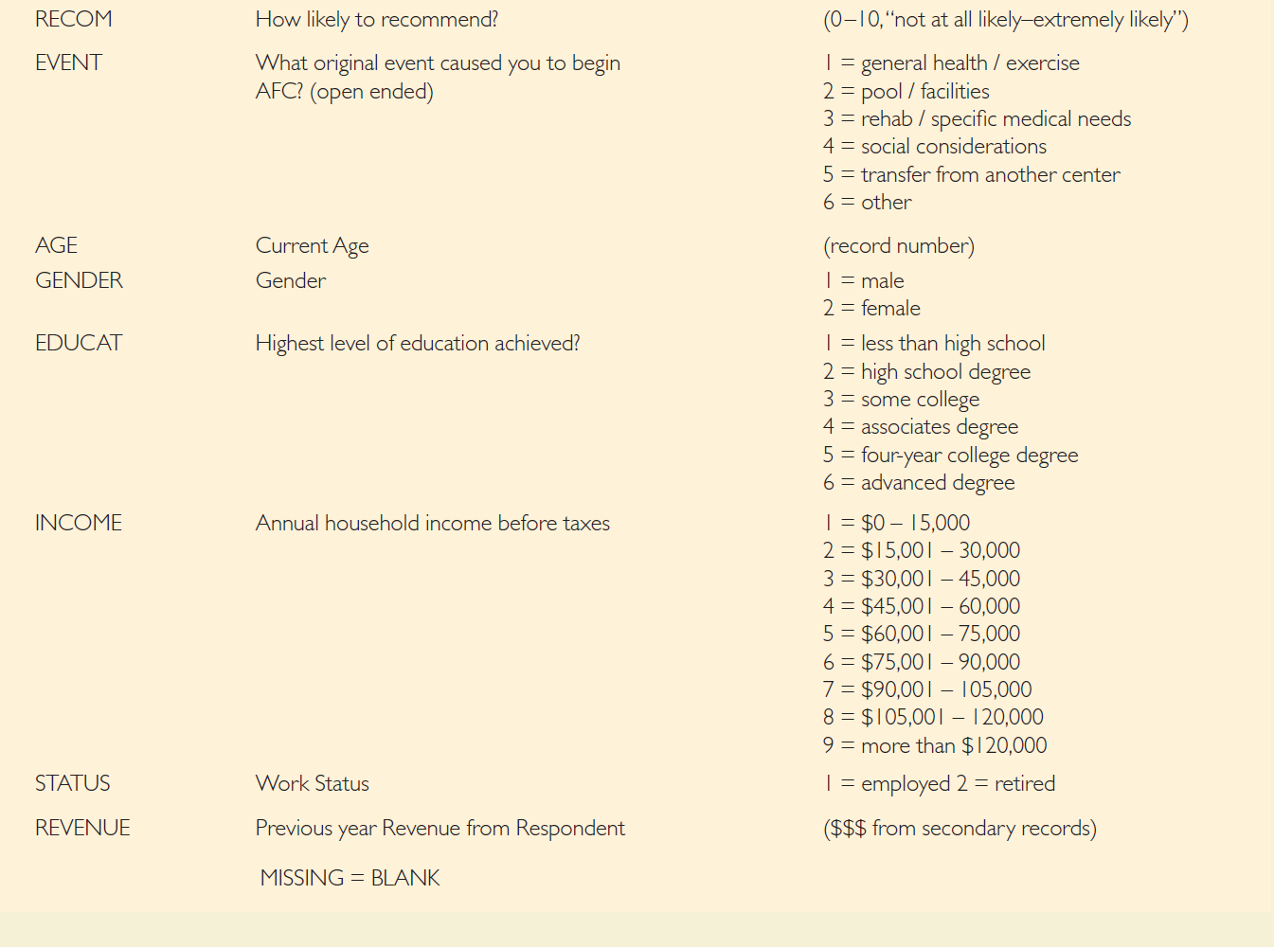
Developing a Codebook (3 of 3)
Continued.

